Slide 1
Diabetes Prediction
Souvik Chakraborty

Slide 2
Points to Explore
Problem Statement & Task
Approach to Address
Selected Parameters
Dataset
Tools & Libraries
Model Pipeline
Results, Model Selection & Conclusion
  date of delivery – within 35 days

Slide 3
Problem Statement & Task
Problem
Task
Diabetes is a type of chronic disease which is more common among the people of all age groups. Predicting this disease at an early stage can help a person to take the necessary precautions and change his/her lifestyle accordingly to either prevent the occurrence of this disease or control the disease.
Prepare the dataset with a reproducible preprocessing pipeline.
Build a classifier and validate it with 5-fold cross-validation and a held-out test set.

Slide 4
Approach to Address
Before coding
Selecting five clinical predictors.
Evaluating parameters; age, gender and blood glucose are excluded.
During coding
Scaling numeric inputs and target-encoding smoking history inside one pipeline.
Creating a stratified 80/20 train and test split.
Validating with 5-fold cross-validation and a test set to select the model.

Slide 5
Parameters
Hypertension
Heart Disease
Smoking History
Hypertension and diabetes share common causes and risk factors. A person with one condition is at higher risk of developing the other.
Diabetes and heart disease often go hand in hand. Protecting the heart through lifestyle changes also helps manage diabetes.
Smoking is linked to insulin resistance and a higher risk of type 2 diabetes. Categories: never, former, current, No Info.

Slide 6
Parameters
BMI
HbA1c
Not Used (Yet)
At 30 ≤ BMI ≤ 39.99, diabetes risk is about double that of persons with normal BMI (HR = 1.98 men, 1.96 women).
HbA1c reflects average blood sugar over about three months. A high value signals higher risk of diabetes and its complications.
Age, gender and blood glucose are in the dataset but excluded from this model version. They are candidates for the next iteration.

Slide 7
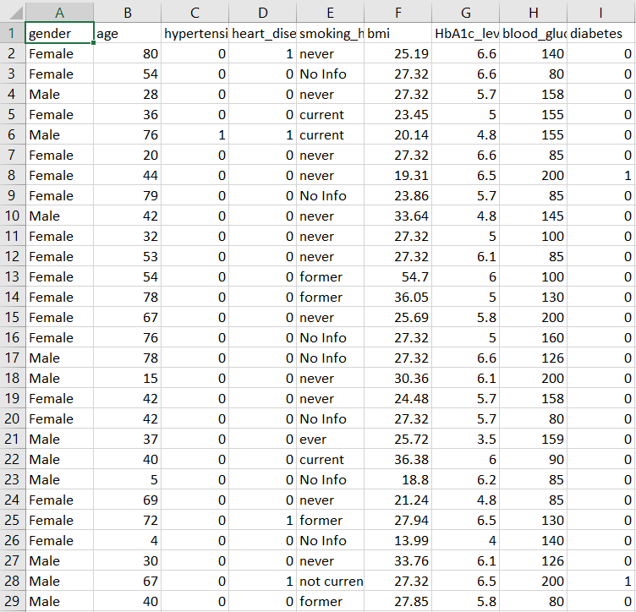
Dataset
100,000 records | 9 columns | 8.5% diabetic

Slide 8
Used
Software
Libraries
Model Pipeline
MS-Excel (to inspect the dataset)
VS Code (Python code for the model pipeline)
1. Pandas
2. NumPy
3. Scikit-Learn
4. zipfile
  1. StandardScaler
  2. TargetEncoder
  3. Logistic Regression

Slide 9
Pipeline
Split: 80% train / 20% test (stratified)
Numeric features (4): StandardScaler
Smoking history: TargetEncoder (smooth = auto, cv = 5)
Classifier: Logistic Regression (max_iter = 2000)
Validation: stratified 5-fold CV on training data
Selection: test vs CV stability check (ROC-AUC, recall)

Slide 10
Output: Test Set
Test-set results
Observation
Accuracy: 0.9434
Precision: 0.8413
Recall: 0.4118
F1-score: 0.5529
ROC-AUC: 0.9066
ROC-AUC above 0.90 and precision of 0.84 show strong, reliable discrimination. Recall is only 0.41, so about 4 in 10 diabetic patients are detected at the 0.5 threshold. Accuracy is inflated by class imbalance (8.5% diabetic).

Slide 11
Output: 5-Fold CV
Fold | Accuracy | Precision | Recall | F1-score | ROC-AUC
Fold 1 | 0.9434 | 0.8503 | 0.4051 | 0.5488 | 0.9008
Fold 2 | 0.9434 | 0.8560 | 0.4022 | 0.5473 | 0.9040
Fold 3 | 0.9466 | 0.8719 | 0.4353 | 0.5807 | 0.9087
Fold 4 | 0.9421 | 0.8308 | 0.4007 | 0.5407 | 0.9019
Fold 5 | 0.9445 | 0.8471 | 0.4235 | 0.5647 | 0.9062
Mean ± Std | 0.9440 ± 0.0017 | 0.8512 ± 0.0149 | 0.4134 ± 0.0153 | 0.5564 ± 0.0162 | 0.9043 ± 0.0032
Fold-to-fold variation is small (ROC-AUC std 0.0032) and the test results fall within the CV range, so the model is stable and not over-fitted.

Slide 12
Conclusion
A logistic regression pipeline built on five clinical indicators separates diabetic from non-diabetic patients well (ROC-AUC about 0.90) and performs consistently across five folds and an independent test set. Precision is high (0.84), but recall (0.41) is too low for stand-alone screening. The model is therefore selected as a validated baseline; next steps are threshold tuning, additional predictors and external validation before clinical use.

Slide 13
Thank
You
  Souvik Chakraborty
https://www.linkedin.com/in/souvik-chakraborty-a14a86204/

